Slide 1

XEALISTIC
XR FOR EVERYONE
www.xealistic.com

Slide 2

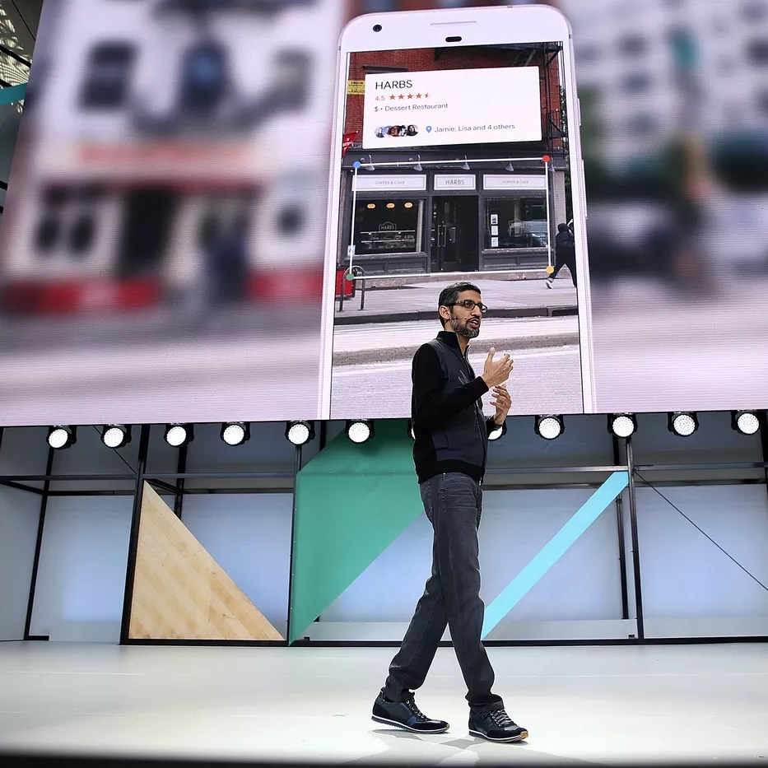
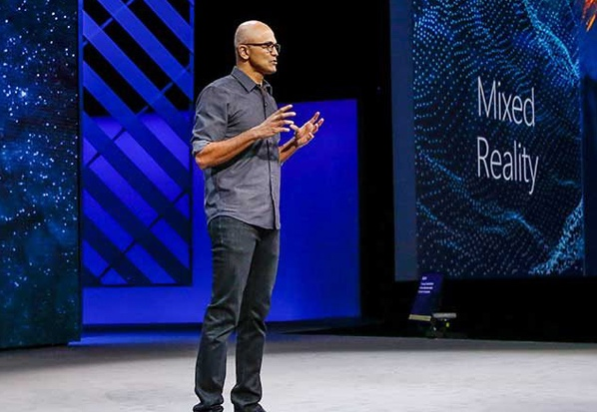
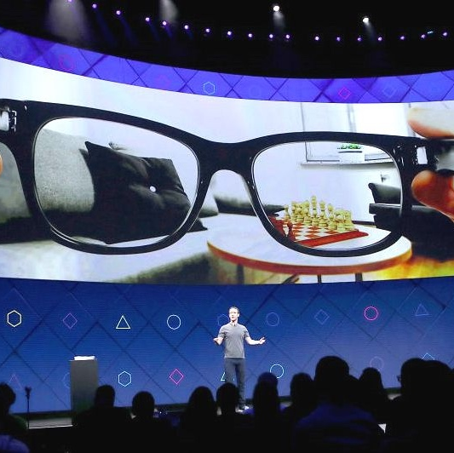



EVERYONE TALKING XR (Extended Reality)
www.xealistic.com

Slide 3
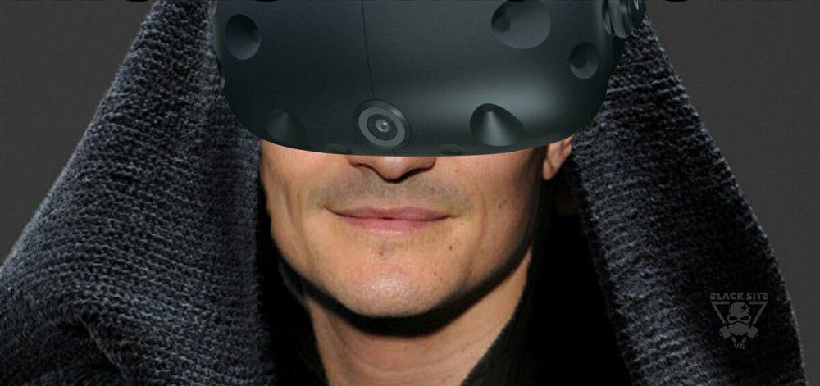

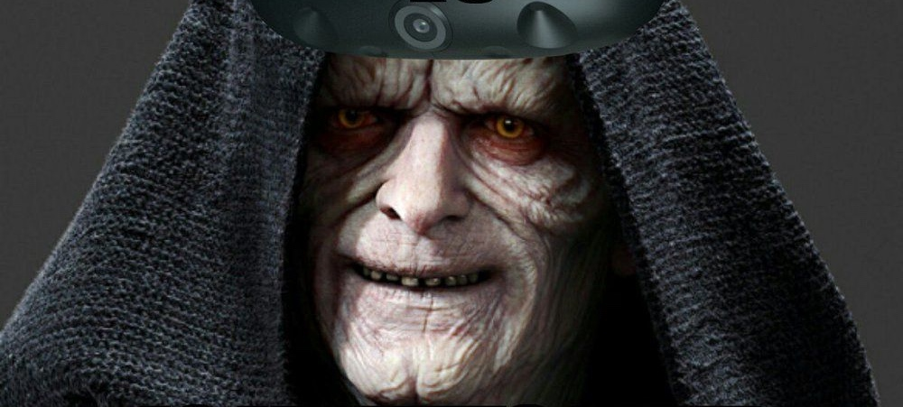
DEMO
THE
PROBLEM
VR is “COOL”
Expensive content
Difficult to author XR content
Talent and tool availability for making XR content
PROPOSAL
Oops! Its to expensive, I don’t have enough content and I can’t make more myself.

Slide 4
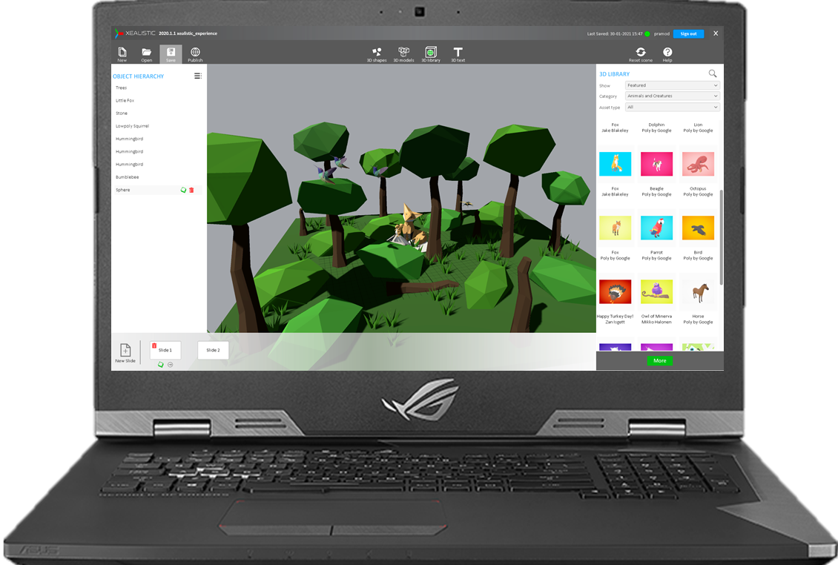
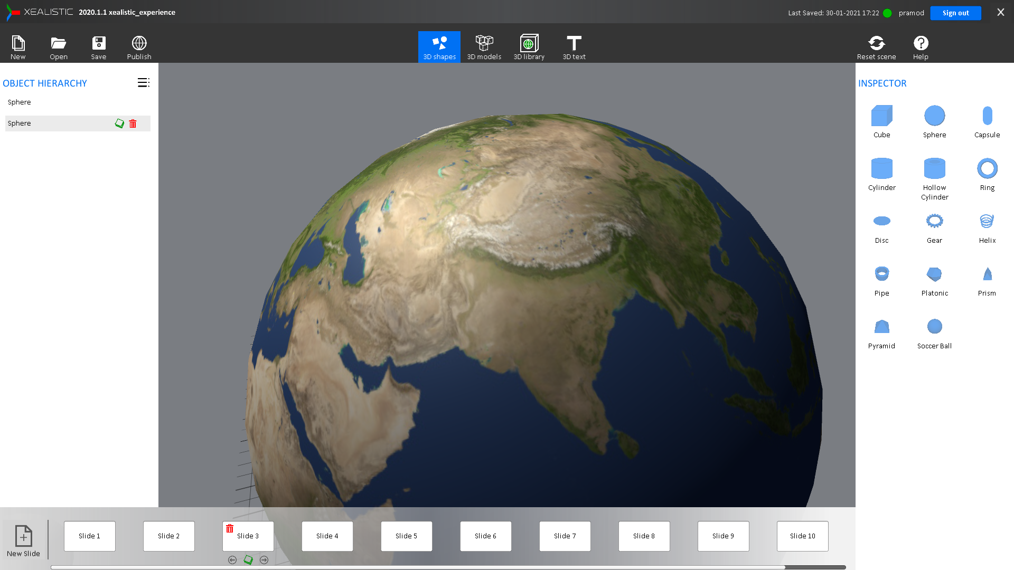
XEALISTIC WILL BRING XR FOR EVERYONE
Ready Made Augmented Reality Content Library for Education
CBSE Science Curriculum for Junior and Senior classes
Content for Space and Other Exiting Topics that need imagination.
www.xealistic.com

Slide 5

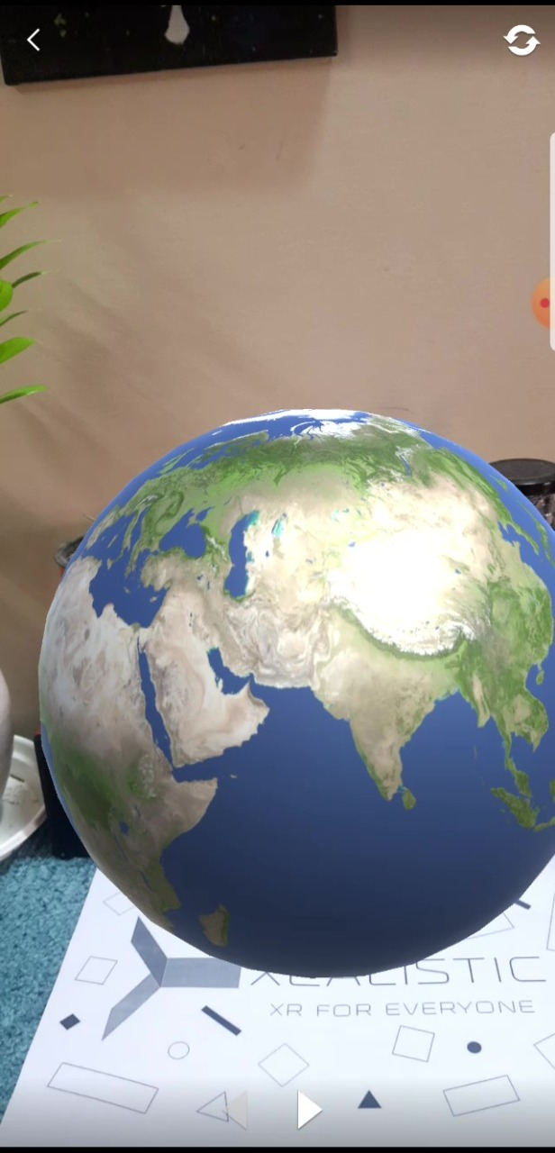
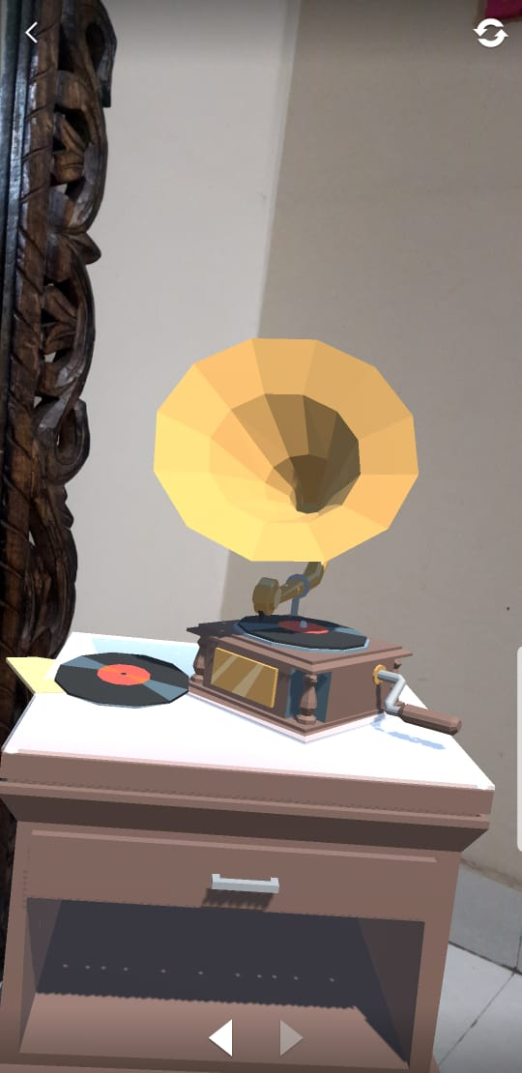
XEALISTIC WILL BRING XR FOR EVERYONE
AR/VR/MR “NO Code” Authoring Platform for Non-Tech Users
Multi-Platform Compatibility
Pre-Authored Content and Templates
Sharing and Market Place Capabilities to Monetize
www.xealistic.com

Slide 6
THE TOOL
THINK
CREATE
BUILD
3D Shapes
AUTHORING TOOL
Instant prototyping of augmented reality content for various domains.
Huge 3D Asset Library
Animated Models
Multiple Textures

Slide 7
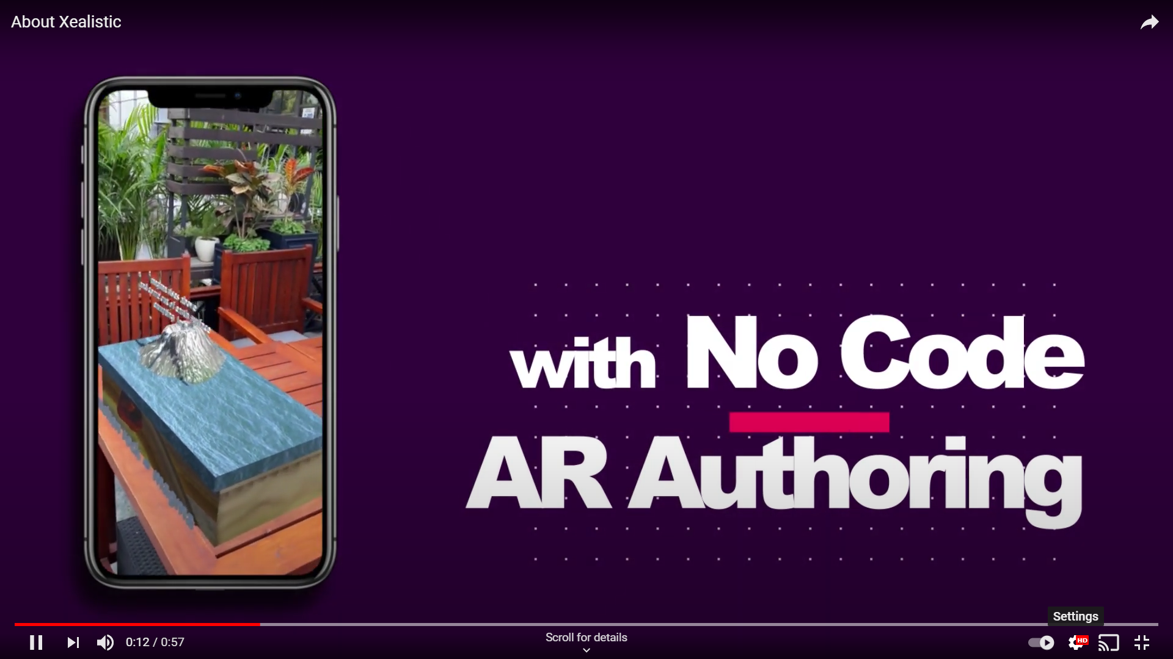
PRODUCT DEMO VIDEO LINK
https://youtu.be/ZUjokrykxUI

Slide 8
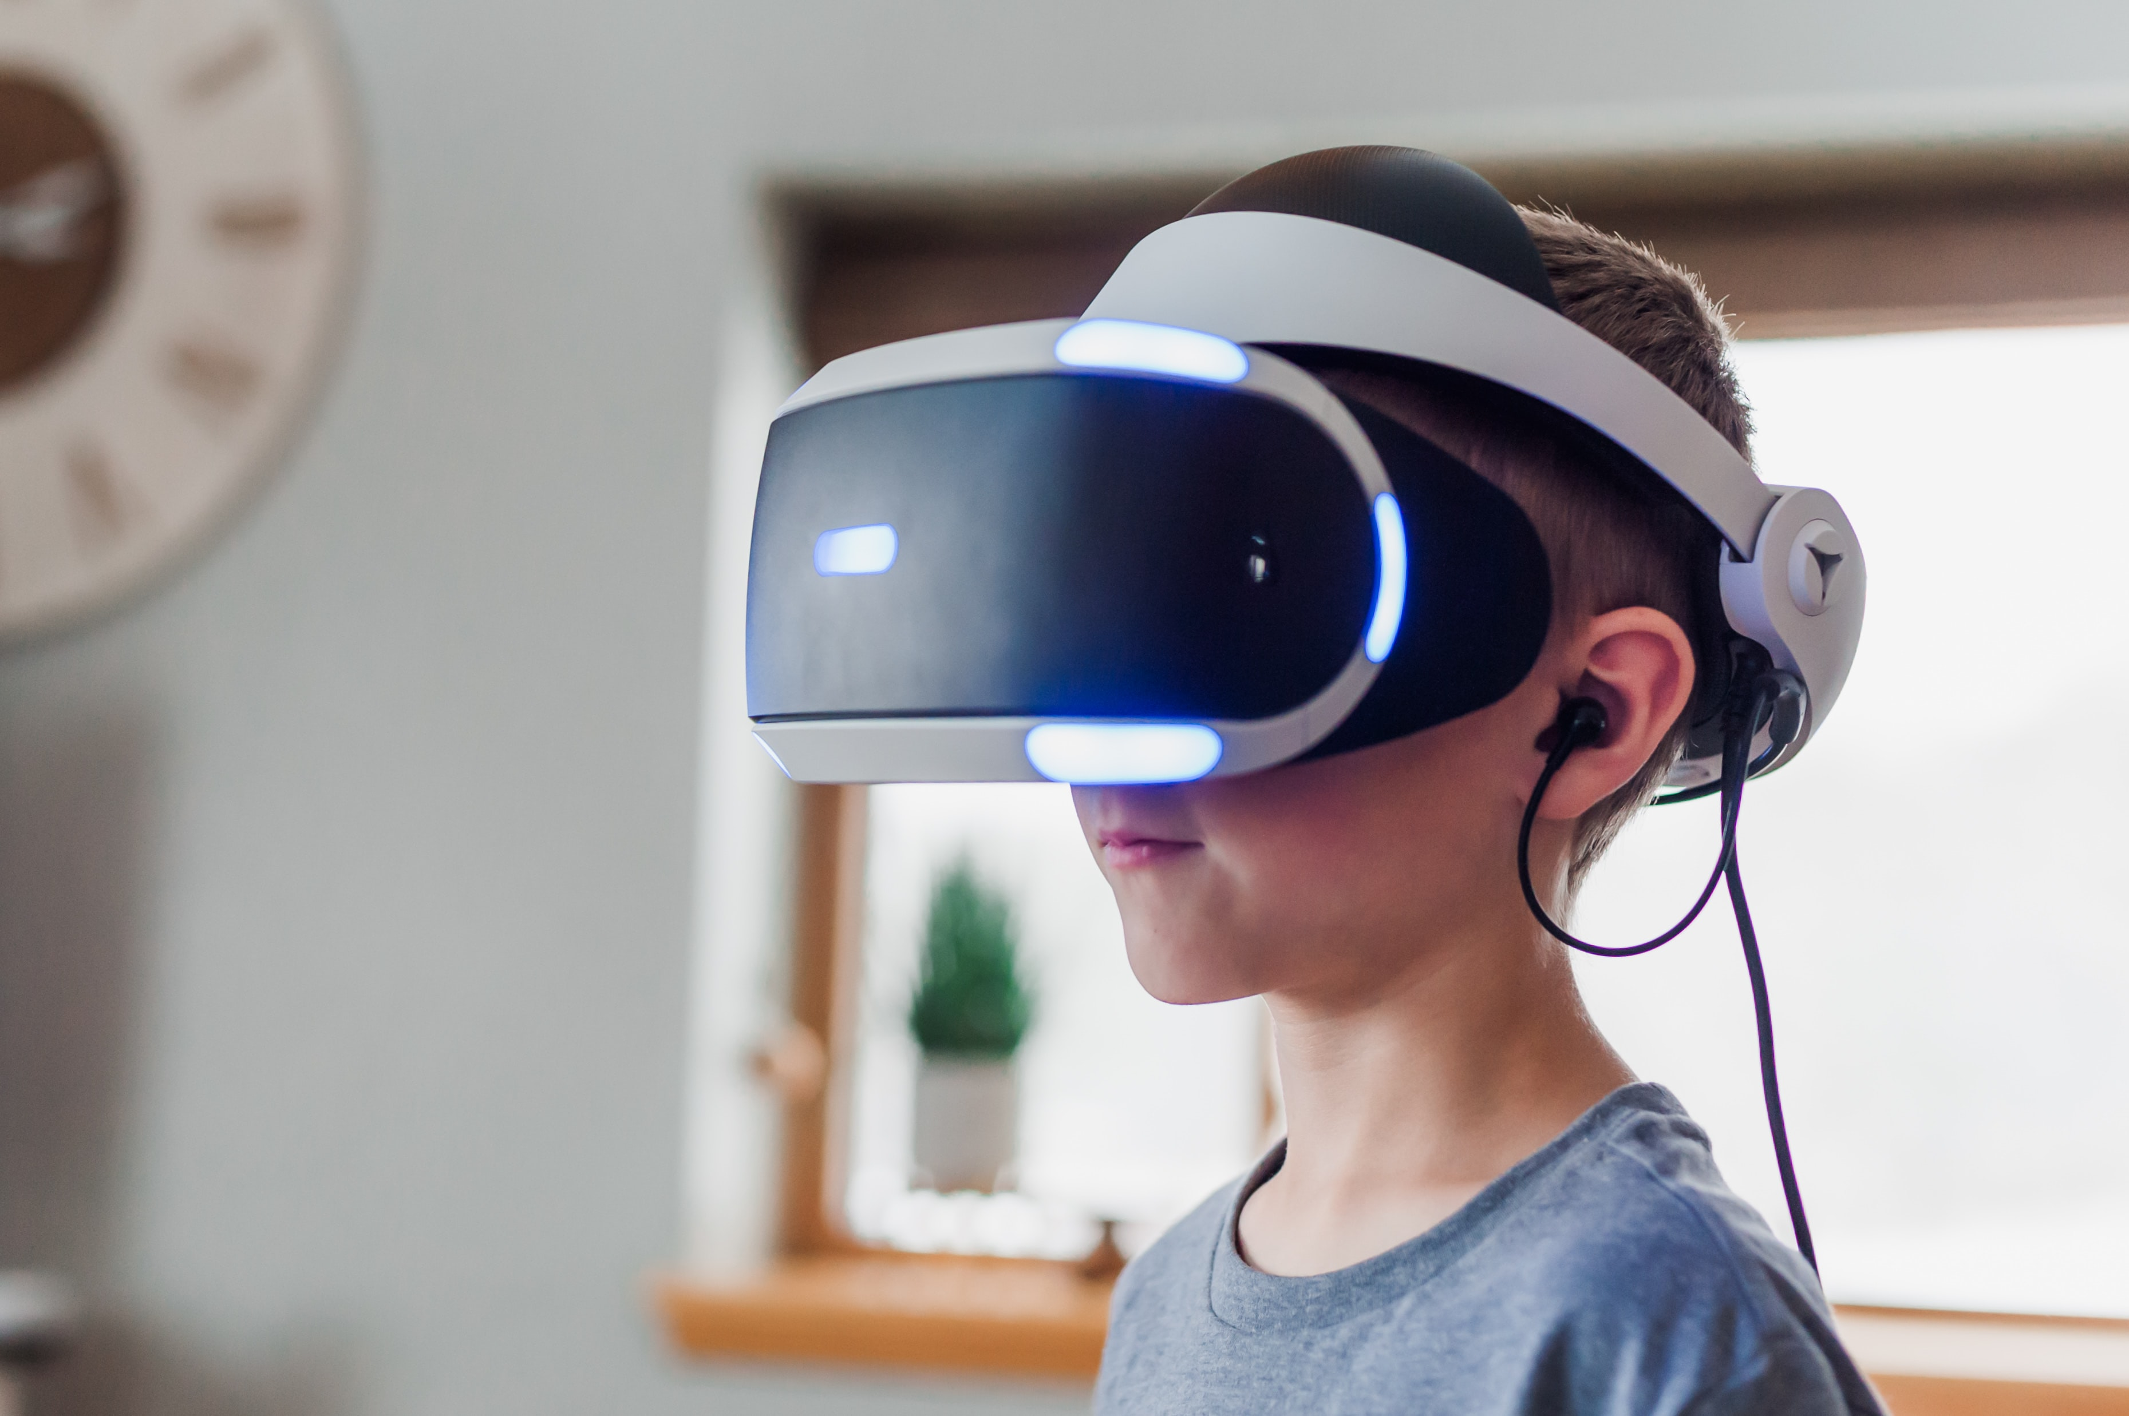
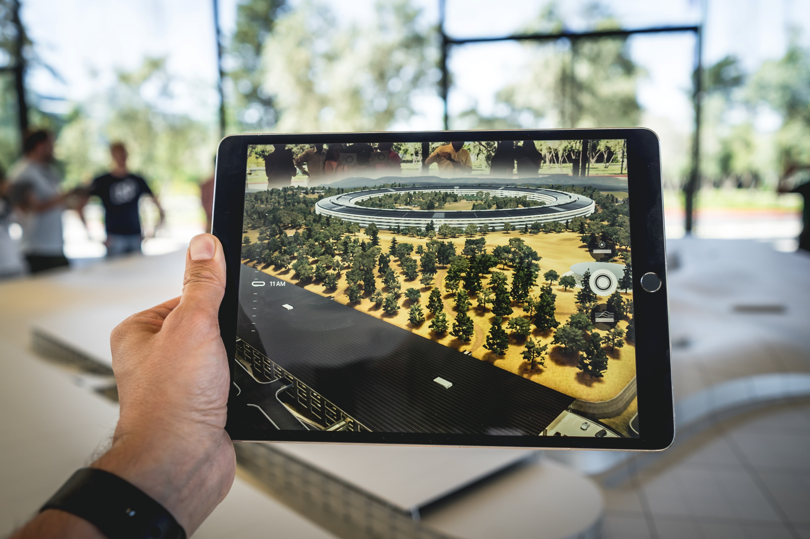
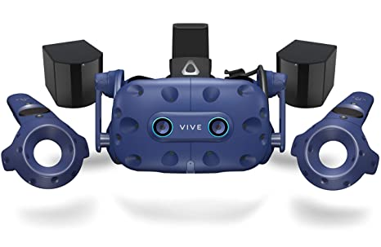
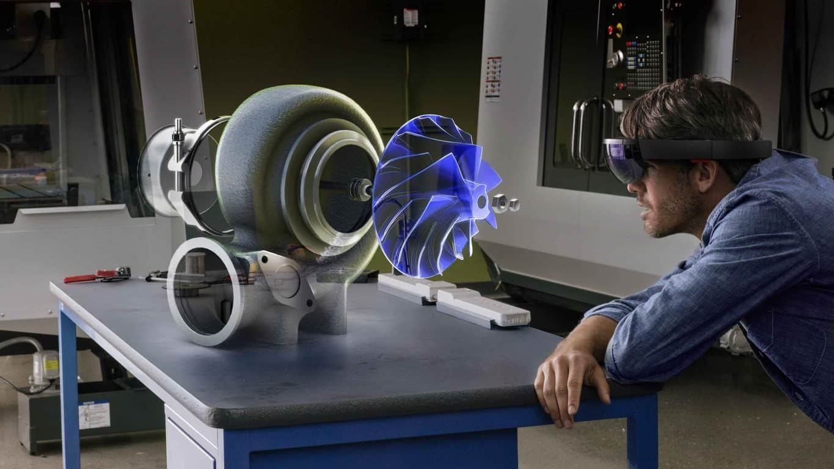
Virtual Reality
Augmented Reality
MULTI-PLATFORM
Mixed Reality
Mixed Reality

Slide 9


ARCHITECTURE
User
content
XEALISTIC CLOUD
Authoring Tool
Asset
library
AUTHOR
Template library
Multi platform access
Pc, phone, tablets, VR/AR/MR glasses
CONSUMERS
www.xealistic.com
WWW.XEALISTIC.COM

Slide 10
MARKET – EdTech & Others
Kids learn AR creation by easy means
Easy to author education content for trainers and educators (they are looking for differentiator in the online race)
Content libraries by educational institutions and organization
Toys and hobby classes for kids
www.xealistic.com
WWW.XEALISTIC.COM

Slide 11




OTHER MARKETS
Conferences
Industrial
Onboarding
Skills Training
Engage audience with an interactive, rich media presentations
Offer product design apps and safe workforce training environment
Provide efficient training for the corporate masses
Master exploratory and spatial learning techniques
www.xealistic.com
WWW.XEALISTIC.COM

Slide 12
TRACTION(pre-launch)
INTEREST from:
4 schools (SPEAKING TO 30)
2 colleges
Hackathon planned for 5000+ users
Positive feedback from workshops done at various colleges
Signed contract with one research company
www.xealistic.com
WWW.XEALISTIC.COM

Slide 13
PRICING MODEL
FREEMIUM SUBSCRIPTION MODEL
Free
Pro
Enterprise(b2b)
www.xealistic.com
WWW.XEALISTIC.COM

Slide 14
PROJECTIONS(only ed-tech)
Proposed Pricing: 5$/User/Month
Financials: Post Funding(Only EdTech)
Forecast Post funding | Revenue
FY 2020-21 | -
FY 2021-22 | 300.000 (5000 Students @ 5$/month)
FY 2022-23 | 1.8 million (30000 Students @ 5$/month)
FY 2023-24 | 30 million (500000 Students @ 5$/month)
www.xealistic.com
WWW.XEALISTIC.COM

Slide 15

FUNDING REQUIREMENT
Team expansion
Go-to market
Product enhancement and content building
International expansion
Funds Required: 100,000 USD
www.xealistic.com
WWW.XEALISTIC.COM

Slide 16
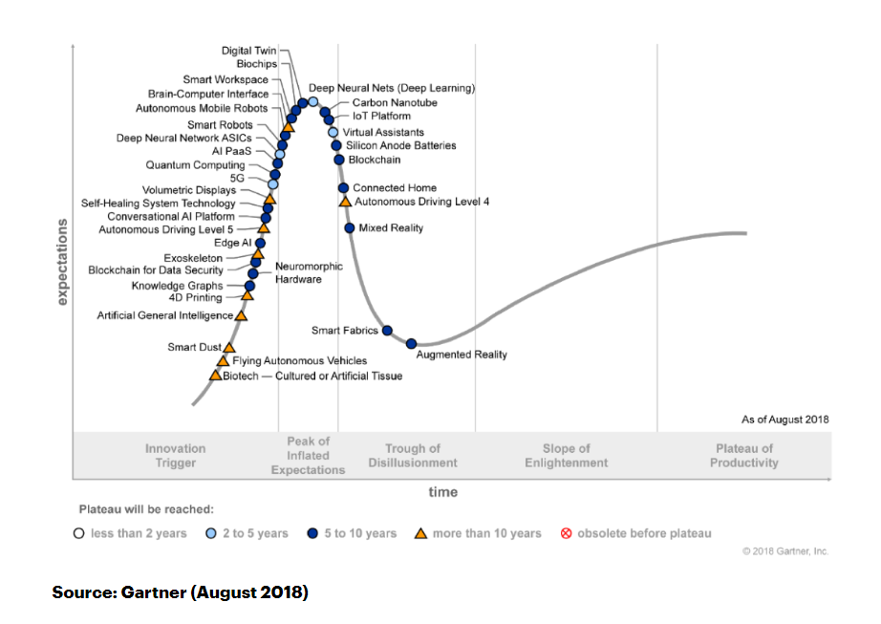
MARKET SIZE
Gartner Says 100 Million Consumers Will Shop in Augmented Reality Online and In-Store by 2020
Augmented Reality and Virtual Reality Will Rely on 5G to Change the Customer Experience
Ready Market
On Right time
Hardware Maturing
Increasing Demand of Content
Better understanding and quality
Available Talent
www.xealistic.com

Slide 17


LEADERSHIP TEAM
MUNISH DHIMAN
CEO & Co-Founder
15 Years of Tech Research, AR/VR and Sales Experience
AARTI DHIMAN
CTO & Co-Founder
7 Years of Tech Experience, Gesture Recognition and AR/VR Specialist
www.xealistic.com

Slide 18
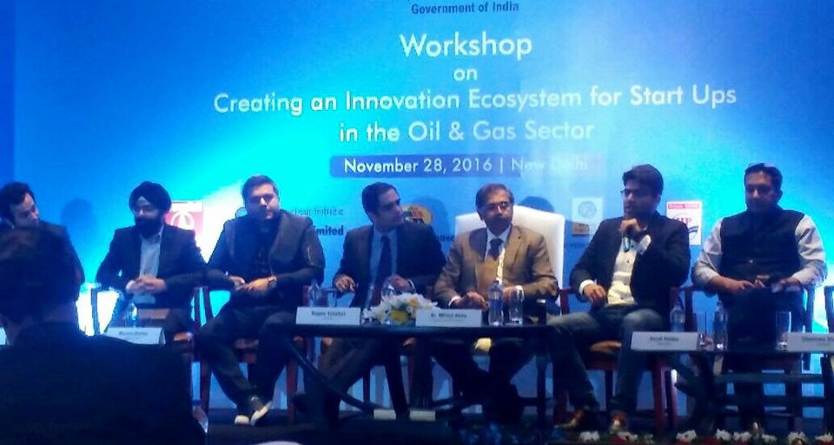
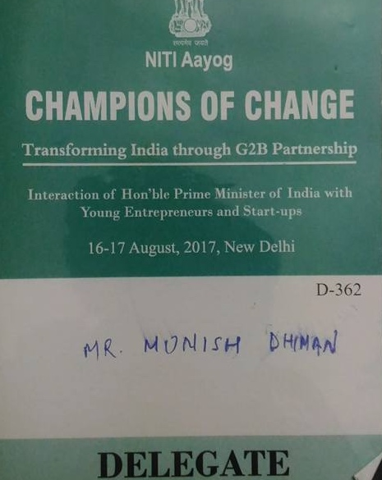
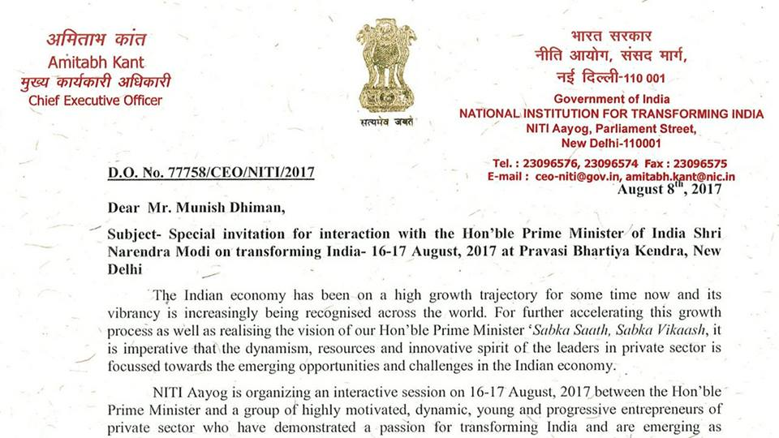
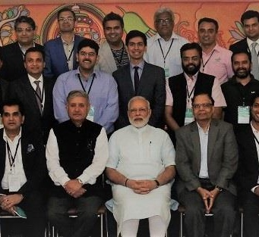
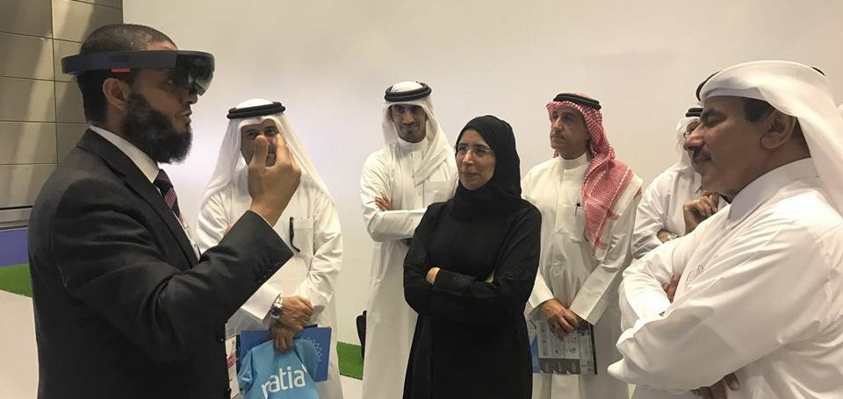
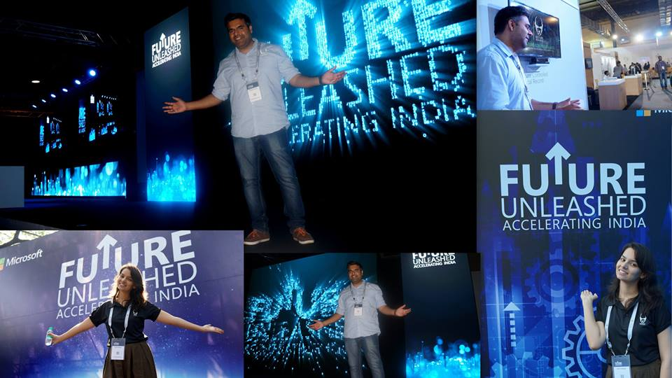
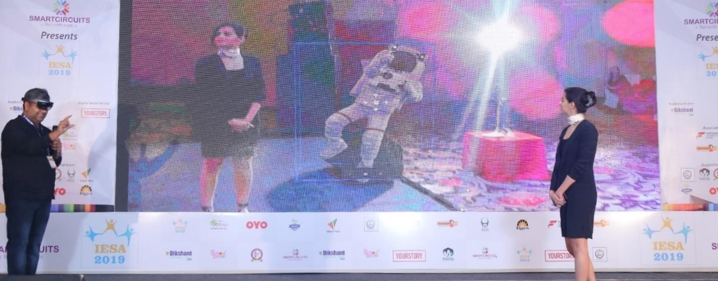
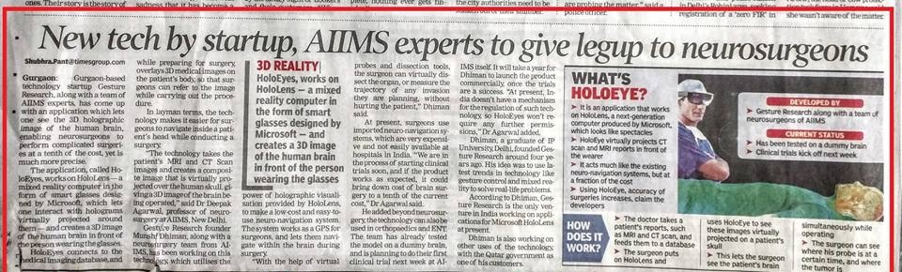
TEAM ACHIEVEMENTS
www.xealistic.com

Slide 19
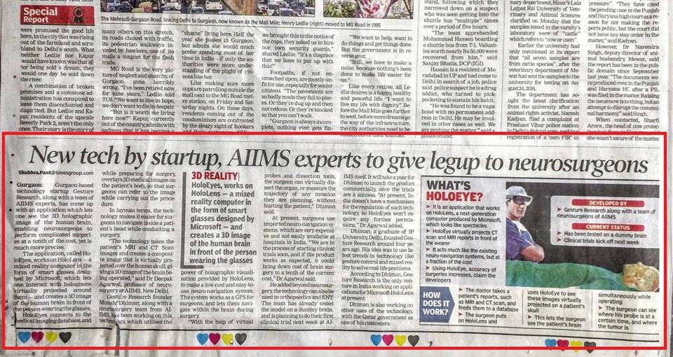
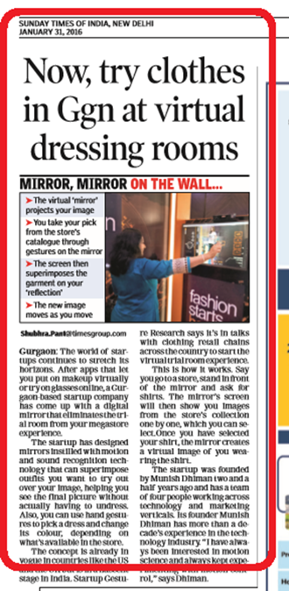
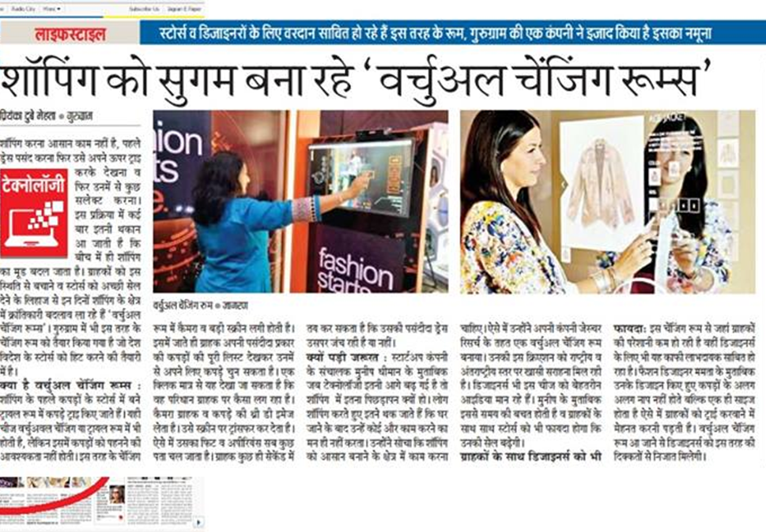
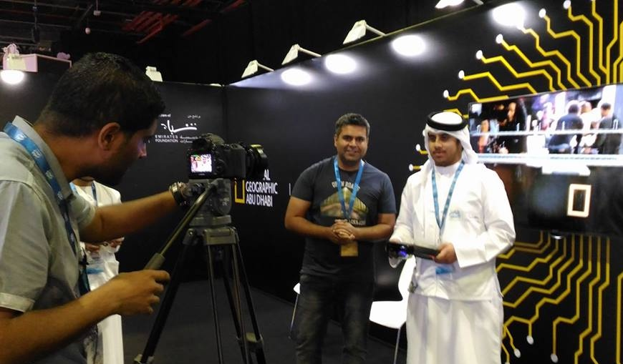
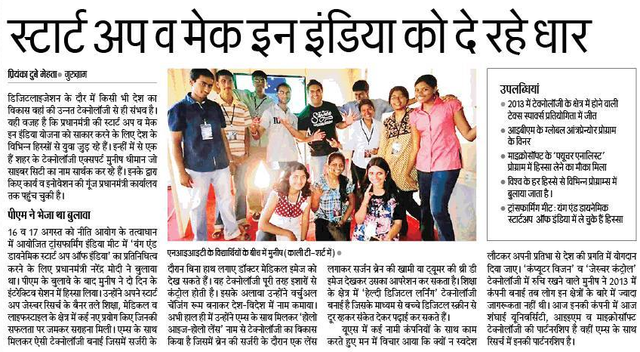
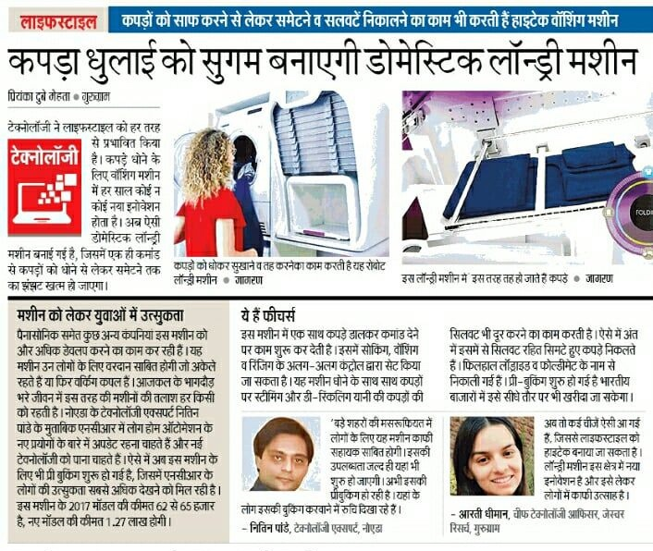
TEAM ACHIEVEMENTS
www.xealistic.com

Slide 20

WE INVITE YOU TO COME AND JOIN US AS WE TRANSFORM
THE WAY THE WORLD CREATES PRESENTATIONS.
www.xealistic.com

Slide 21
Thank you!
Contact Number: +91- 9990322337
Email: aarti@xealistic.com
www.xealistic.com

